Slide 1
ANATOMY OF THE FACE
DR OMOTAYO H A

Slide 2
Skin of the face
Very vascular,rich in sweat& sebaceous glands .
Receives the insertion of facial muscles .
Contains :-
Facial muscles ,vessels & nerves & fat .
Superficial fascia
Deep fascia
ABSENT except ………

Slide 3
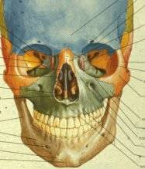
Face
Sensory supply of face is trigeminal
5th cranial nerve
C2
Motor supply
Muscles of facial expression
Facial nerve 7th cranial

Slide 4
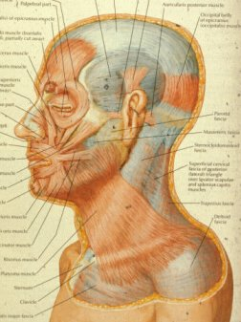
Scalp
Skin
Subcutaneous
Epicranial aponeurosis
Three fused together
Loose areolar tissue
Periosteum
Occipito-frontalis
Attached posteriorly
No anterior attachment

Slide 5
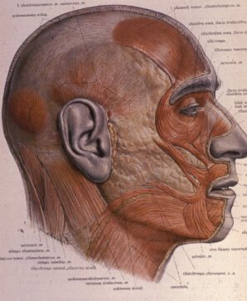
Scalp
Occipital portion of occipito-frontals and epicranial aponeurosis attached to bone posterior
Frontal no bony attachment
Scalp wounds cause black eyes
Occipital belly
Posterior auricular of facial nerve
Frontal belly by temporal of facial nerve

Slide 6
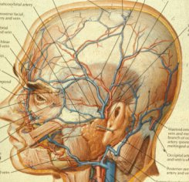
Blood and Nerve supply of scalp
Supraorbital vessels and nerve
Scalp as far as vertex
Posterior scalp
Greater occipital C2
Occipital and posterior auricular vessels
Zygomatico temporal
Greater auricular

Slide 7
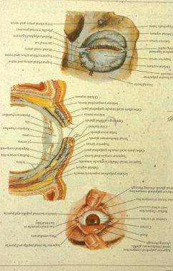
Eyelid
Skin
Orbicularis oculi
Palpebral portion
Orbital septum and tarsal plates, mebonium glands
Medial palpebral ligament anchors tarsal plates to anterior lacrimal crest
Conjunctival sac

Slide 8
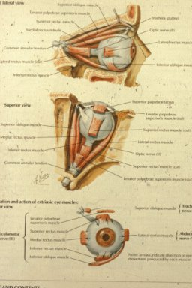
Levator Palpebrae Superioris
Arises from back of roof of orbit
Inserted into skin of upper eyelid
The superior tarsal plate
Superior fornix of conjunctiva

Slide 9
Levator Palpebrae Superioris
Elevates upper eyelid
Voluntary muscle supplied by 3rd oculomotor nerve
Smooth muscle
Sympathetic T1
Superior cervical ganglion

Slide 10
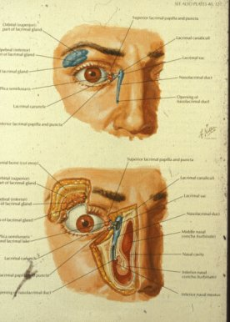
Lacrimal Apparatus
Lacrimal gland
Conjunctival sac
Puncta
Cananiculi
Nasolacrimal sac
Nasolacrimal duct
Inferior meatus nose

Slide 11
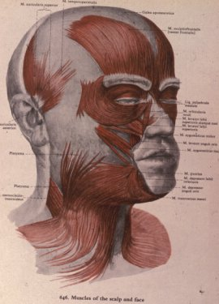
Muscles of Facial Expression
Muscles of second branchial arch
Nerve second arch is facial nerve
Inserted into skin of face
Buccal pad of fat
No deep fascia in face
Except around parotid
Parotid duct

Slide 12
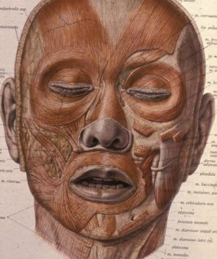
Orbicularis Oculi
Orbital closes eyelid tightly, buries eyelashes
Makes conjunctival sac smaller
Finer palpebral portion in eyelid
Anterior to tarsal plate
Closes eye in blinking and sleep
No action on conjunctival sac

Slide 13
Muscles of Facial Expression
Occipito frontalis
Orbicularis oculi
Orbicularis oris
Buccinator
Platysma
Skin of face
Incisions

Slide 14
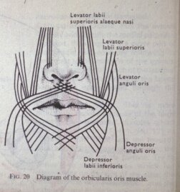
Muscles of Facial Expression
Orbicularis oris
Intrinsic: origin and insertion inside, only alters shape
Extrinsic: origin outside, alters position

Slide 15
Muscles of Facial Expression
Incisions in the face evert edges
Platysma
Inserted into lower border of mandible
Posterior fibres form risorius

Slide 16
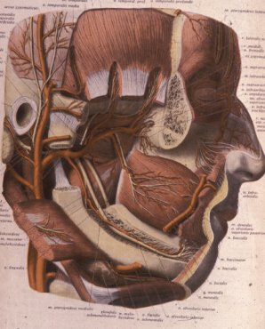
Buccinator
Buccinator 7th nerve
Accessory muscle of mastication
Outer aspect of maxilla and mandible
Related to molar teeth
Pterygomandibular raphe
Action keeps food out of vestibule
Sucking
Blowing trumpet

Slide 17
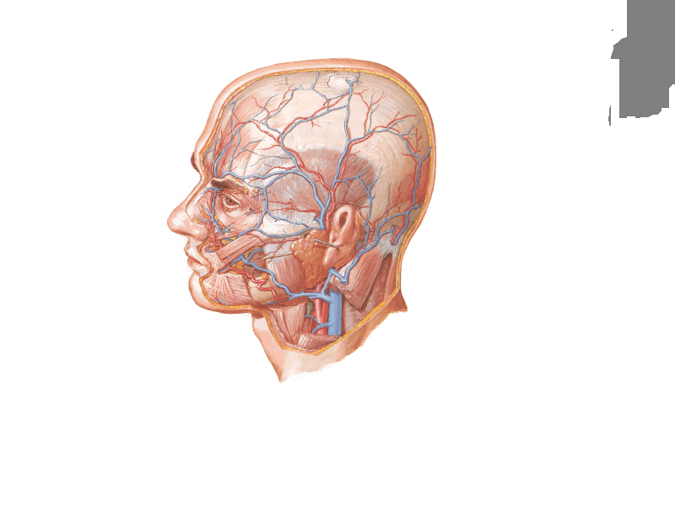
Auricle
Buccinator
Parotid gland
Masseter
Facial vessels

Slide 18

Blood Supply of
the Face

Slide 19

Arteries

Slide 20
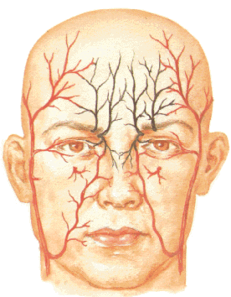
Supraorbital A.
Superficial temporal A.
Supratrochlear A.
Buccal A.
Infraorbital A.
Facial A.
Mental A.

Slide 21
Facial vein
Masseter
Facial artery

Slide 22
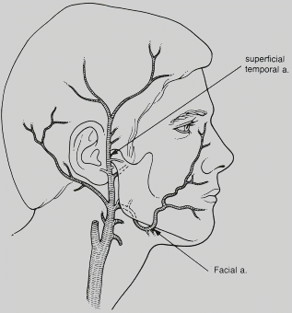
Branches
Lat.nasal a.
Sup.labial A.
Inf.labial A.
Facial A.

Slide 23
Superficial
temporal A.
Transverse
facial A.
Parotid duct

Slide 24
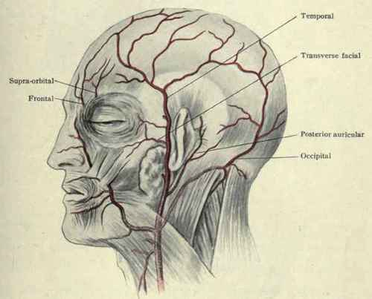
Superficial
temporal A.
Pulsation sites
Facial A.

Slide 25
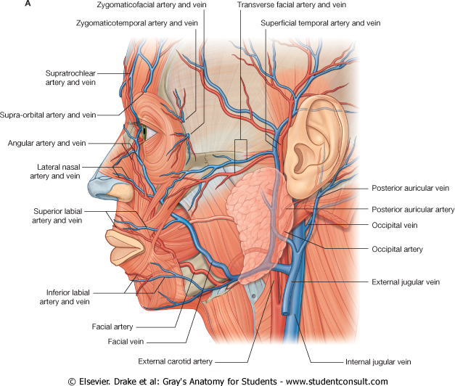
Transverse facial Vs.
superficial temporal Vs.
Tragus
Lat.Nasal Vs.
Sup.Labial Vs.
Inf.Labial Vs.
Masseter
Facial A.
Facial V.

Slide 26

Facial Vein

Slide 27
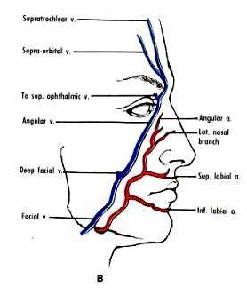
Supratrochlear V.
Supra-orbital V.
facial vein

Slide 28
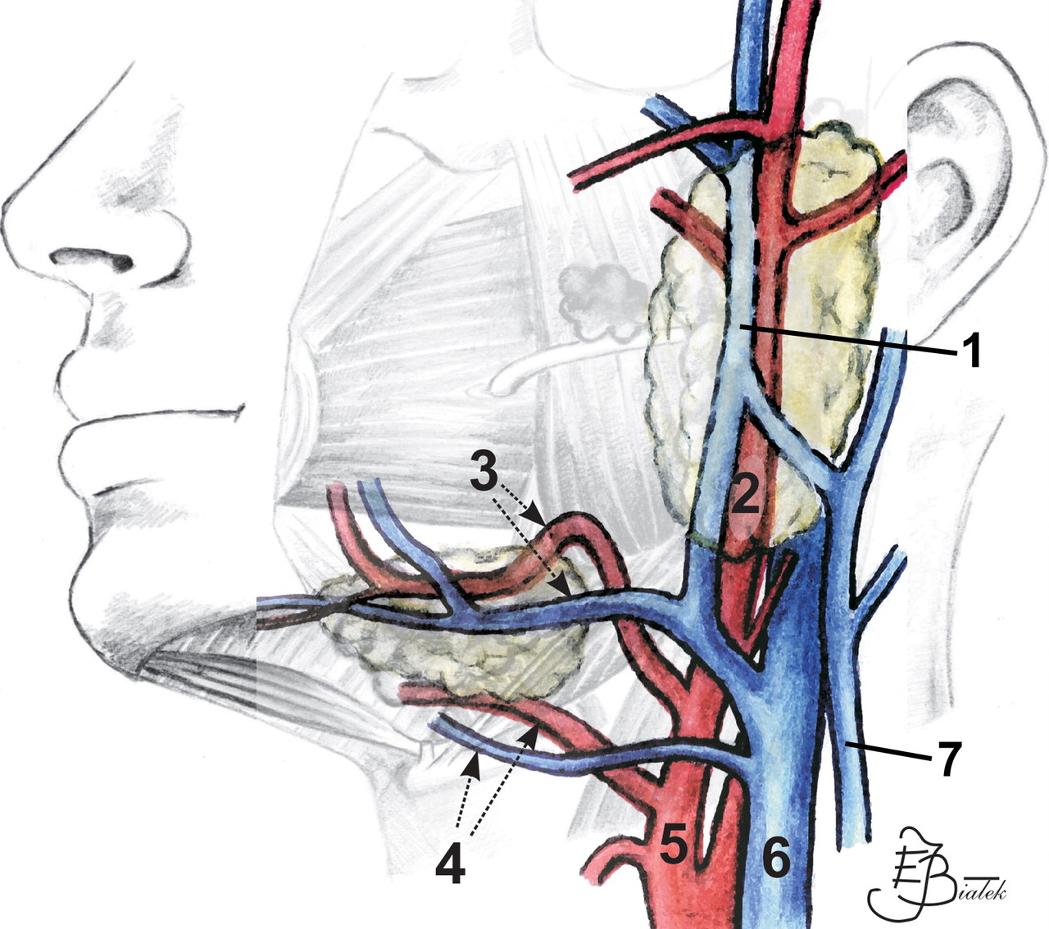
Maxillary V.
Superficial
Temporal V.
Retro-
Mandibular V.
Facial Vs.
Post.auricular
V.
Ext.jugular V.
C.Facial V.
Int.jugular V.

Slide 29
Maxillary V.
Superficial
Temporal V.
Retro-
Mandibular V.
Anterior
devision
Posterior
devision
+
+
Facial vein
Post.auricular
V.
=
=
I.J.V.
Common facial
vein
External
Jugular vein

Slide 30
Supratrochlear V.
Supraorbital V.
Cavernous
sinus
To sup.ophthalmic V.
Emissary Vs.
facial V.
Pterygoid venous
plexus
Deep Facial V.

Slide 31
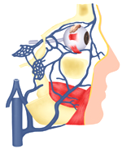
Cavernous
Sinus
Sup.Ophth.
V.
Pterygoid
Venous Plexus
Facial V.

Slide 32
facial vein
Deep facial V.
Sup.oph.V.
Cavernous sinus
Pterygoid venous
plexus
Emissary veins

Slide 33

Dangerous area of
the face

Slide 34
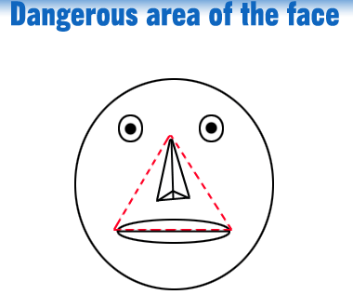
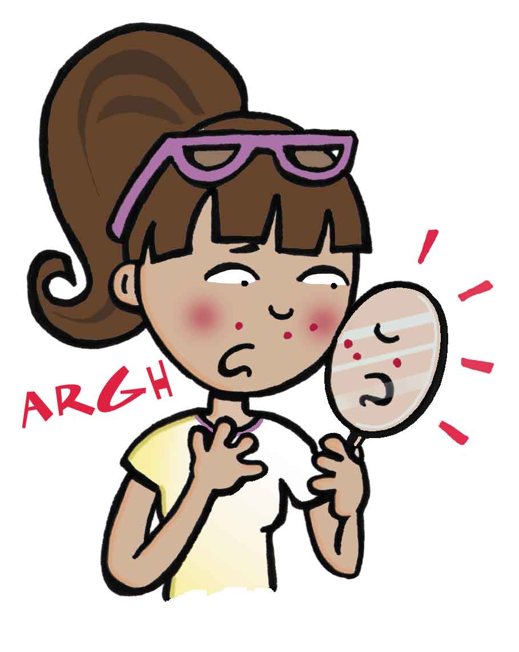

Slide 35

Lymph Drainage

Slide 36
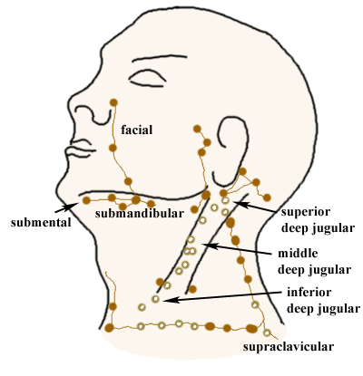
Lymph Drainage
Parotid L.N.

Slide 37
Lymph drainage of the face
Lat.part of the face……..parotid lymph nodes .
Medial part of the face…submandibular lymph nodes .
Central part of lower lip & chin…………submental lymph nodes .

Slide 38

Nerve Supply of
the Face

Slide 39

Nerve supply of the face
Sensory
Motor

Slide 40
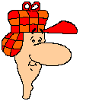
Facial Nerve

Slide 41
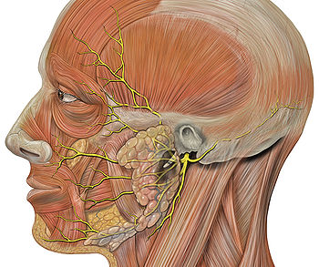
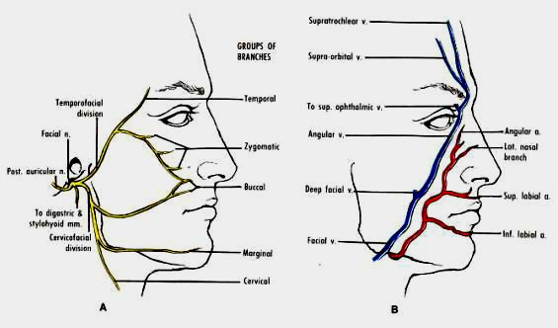
Facial Nerve

Slide 42
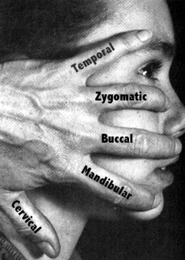

Slide 43
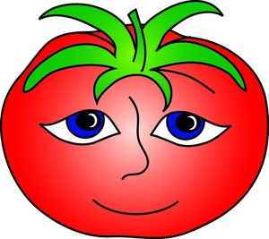
Sensory supply

Slide 44
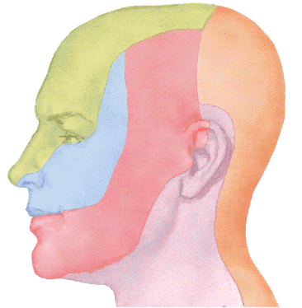
Ophthalmic n
Maxillary n.
Great auricular n.
Mandibular n.

Slide 45
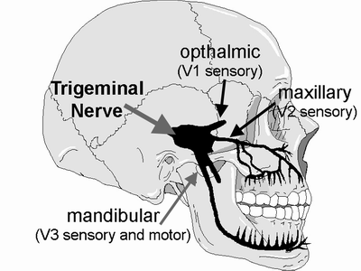
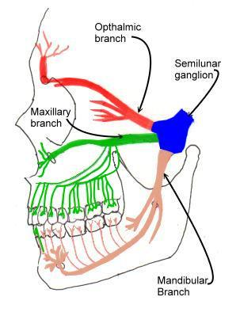

Slide 46
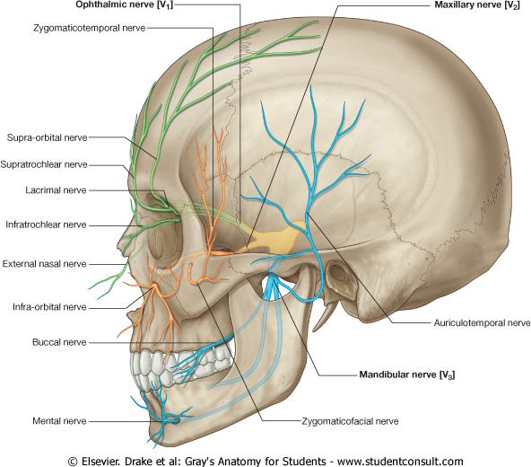
Zygomaticotemporal nerve
Supra-orbital n.
Supra trochlear n.
Lacrimal n.
Infra trochlear n.
External nasal
Infra orbital n.
Auriculotemporal n.
Buccal n.
Mental n.
Zygomaticofacial n.

Slide 47
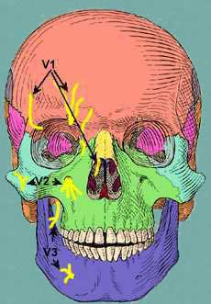
Supra-orbital nerve
Infra-orbital nerve
Mental nerve

Slide 48

Ophthalmic nerve
Supraorbital & supratrochlear nerves…...forehead & upper eyelid.
Lacrimal nerve…lateral part of upper eyelid
Infratrochlear nerve…lower eyelid .
External nasal…nose till the tip .

Slide 49

Maxillary nerve
Infraorbital….palpebral & nasal &labial .
Zygomaticofacial….skin over zygomatic bone .
Zygomaticotemporal….skin of temple.

Slide 50

Mandibular nerve
Mental……lower lip&chin
Buccal….skin over buccinator .
Auriculotemporal…skin over auricle&temple .

Slide 51
FACE: CLINICAL ANATOMY

Slide 52
FACIAL INFECTION
DANGEROUS AREA OF FACE
A triangular area bounded with an apex opposite the medial angles of eyes & nose and a base formed by the upper lip
It is drained by facial vein
It has important communications with cavernous sinus:
supraorbital & superior ophthalmic veins
Facial vein Cavernous sinus
deep facial vein pterygoid plexus of veins emmissary veins

Slide 53
FACIAL INFECTION
DANGEROUS AREA OF FACE
Infection of this area may lead to:
Thrombosis of facial vein
Infection may be transmitted to cavernous sinus leading to cavernous sinus thrombosis

Slide 54
TRIGEMINAL NERVE
Supplies the skin of the face EXCEPT the area over the angle of mandible & parotid gland
Is represented by 3 divisions:
Ophthalmic
Maxillary
Mandibular

Slide 55
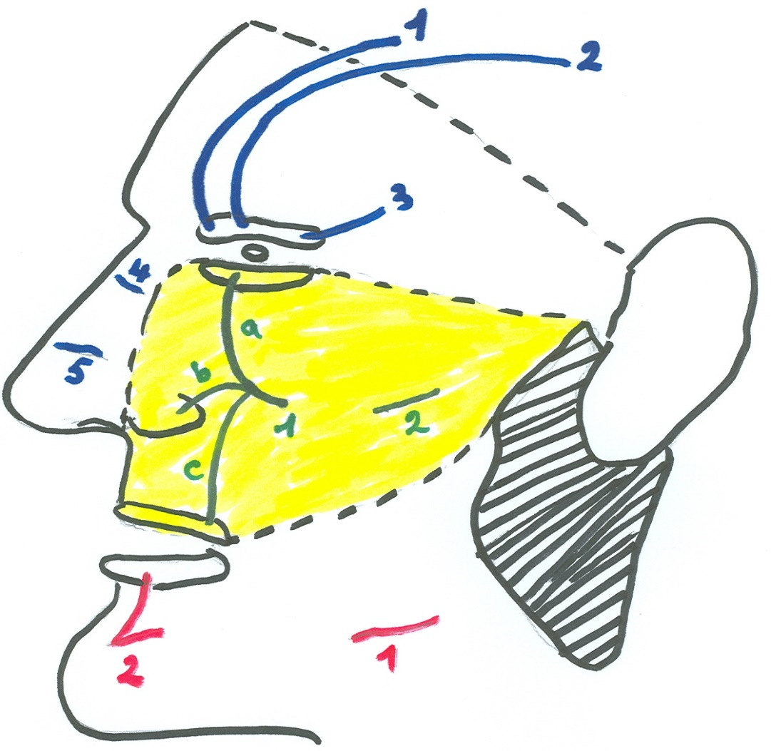
TRIGEMINAL NERVE
OPHTHALMIC:
Supratrochlear: forehead + medial part of upper eyelid
Supraorbital: same
Palpebral branch of lacrimal: lateral part of upper eyelid
Infratrochlear: upper part of nose
External nasal: lower part of nose

Slide 56
TRIGEMINAL NERVE
MAXILLARY:
Infraorbital: divides into: a) palpebral for lower eyelid, b) nasal for ala of nose, c) labial for upper lip
Zygomaticofacial: upper part of cheek

Slide 57
TRIGEMINAL NERVE
MANDIBULAR:
Buccal: lower part of cheek
Mental: lower lip & chin

Slide 58
TRIGEMINAL NEURALGIA
Inflammatory condition affecting one or more of the three divisions of trigeminal nerve
Gives rise to severe pain in the area of distribution of the affected nerve
Surgical treatment may involve:
Alcohol injection of the trigeminal ganglion
Section of the central root of the nerve or of the appropriate division

Slide 59
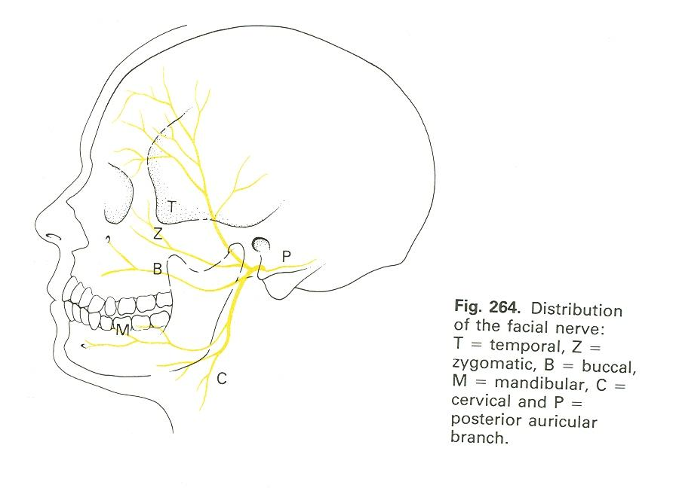
FACIAL NERVE

Slide 60
FACIAL NERVE
Extracranial course:
The nerve leaves the cranial cavity through stylomastoid foramen
The nerve enters the parotid gland & divides into 5 terminal motor branches that emerge from the gland
Extracranial distribution:
After emergence from stylomastoid foramen:
Posterior auricular: to occipital belly of occipitofrontalis muscle
Muscular branch to posterior belly of digastric
Muscular branch to stylohyoid
After emergence from parotid gland:
Temporal: to orbicularis oculi, frontal belly of occipitofrontalis muscles
Zygomatic: to orbicularis oculi muscle
Buccal: to buccinator, muscles of upper lip & nose
Mandibular: to muscles of lower lip
Cervical: to platysma

Slide 61
FACIAL NERVE INJURY
UPPER MOTOR NEURONE LESION (SUPRANUCLEAR LESION): e.g. lesion in pyramidal tracts: paralysis of muscles on the lower quadrant of face opposite to the side of lesion (the patient can close his eye but cannot expose his teeth on the affected side)
LOWER MOTOR NEURONE LESION (NUCLEAR OR INFRANUCLEAR LESION): e.g. Bell’s palsy: paralysis of all muscles of face on same side of lesion (the patient cannot close his eye and cannot expose his teeth on the affected side)

Slide 62
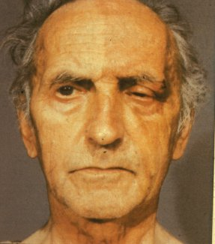
Bell’s Palsy
Lower motor neurone of facial nerve
Forehead and all the
muscles on the side of lesion are affected

Slide 63
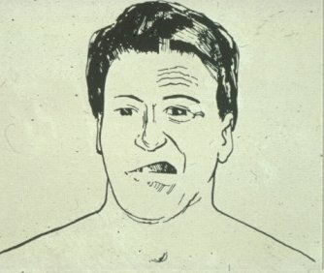
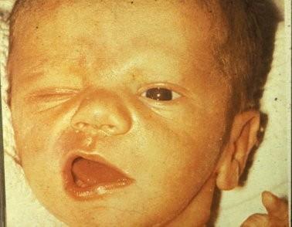
Facial Palsy

Slide 64
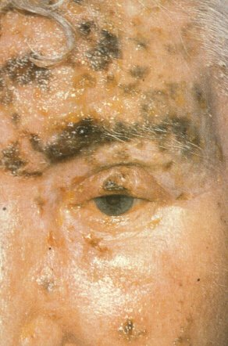
Corneal Reflex
Afferent (sensory) cilary branches nasocilary of ophthalmic of 5th
Efferent (motor)
Zygomatic branch of facial 7th
Last reflex to go

Slide 65
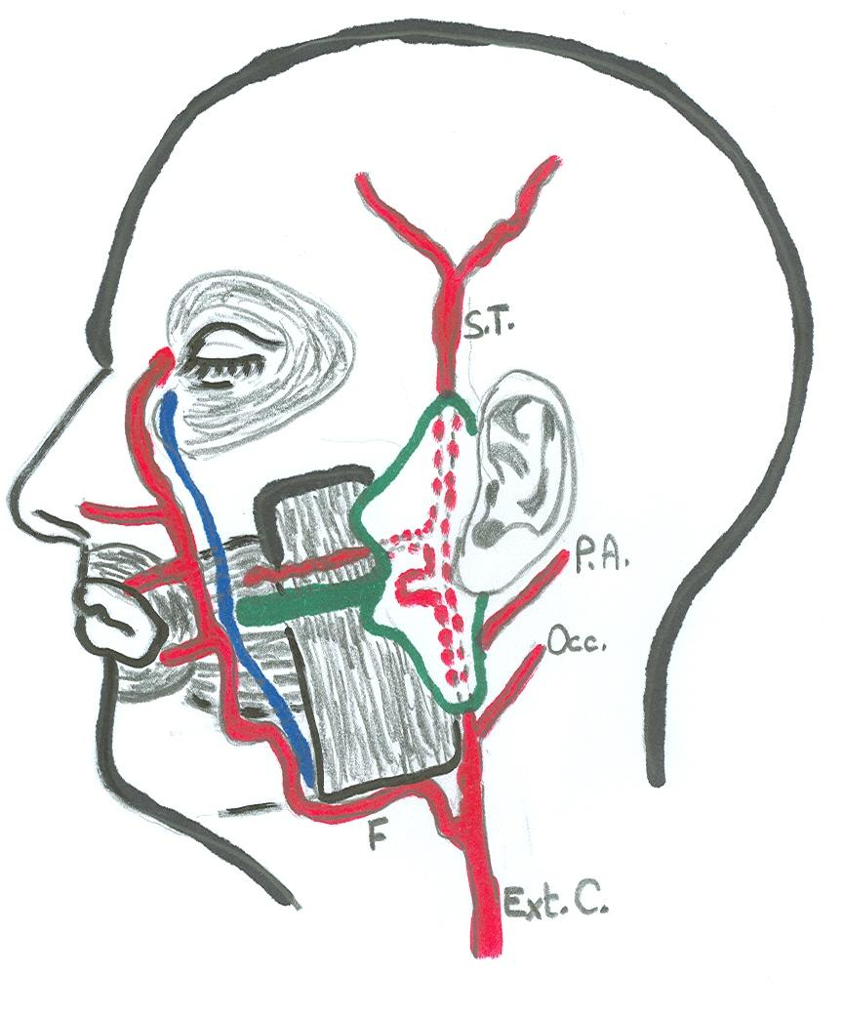
ARTERIES OF FACE

Slide 66
FACIAL ARTERY
ORIGIN: A branch of external carotid in the neck
COURSE IN FACE:
Curves around the lower border of mandible (pulse can be felt)
Ascends: lateral to lips & nose, anterior to facial vein
Runs a tortuous course
TERMINATION: at the medial angle of eye, where it anastomoses with branches of ophthalmic artery
BRANCHES IN FACE:
Inferior labial
Superior labial
Lateral nasal

Slide 67
SUPERFICIAL TEMPORAL ARTERY
ORIGIN: One of the 2 terminal branches of external carotid artery in the parotid gland
COURSE:
Ascends in front of auricle (pulse can be felt)
Accompanies the auriculotemporal nerve
BRANCHES:
Transverse facial: arises inside the parotid gland & runs transversally above parotid duct
anterior & posterior branches: supply the scalp

Slide 68
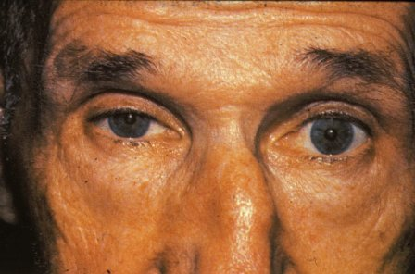
Horner's Syndrome
Caused by brainstem stroke,brachial plexus trauma,tumour, neuronal
lesion
signs include:
Ptosis
Drooping eyelid
Meiosis
Constricted pupil
Anhydrosis
Lack of sweating
Enopthalmos

Slide 69

MCQ

Slide 70

MCQ.1-Pulse felt in front of auricle against the zygomatic arch is that of:-
a.Facial A.
b.Transverse facial A.
c.Zygomatico facial A.
d.Superficial temporal A.
e.Infraorbital A.

Slide 71

MCQ.2.Nerve supply of skin of forehead includes:-
a.Auriculotemporal nerve.
b.Infraorbital nerve.
c.Supra-orbital nerve
d.Supratrochlear nerve.
e. © and (d)

Slide 72



